Slide 1

GitHub Copilot Instructions — Why It Matters
Standardizing AI guidance across our engineering organization to improve code quality, reduce review time, and democratize knowledge.

Slide 2
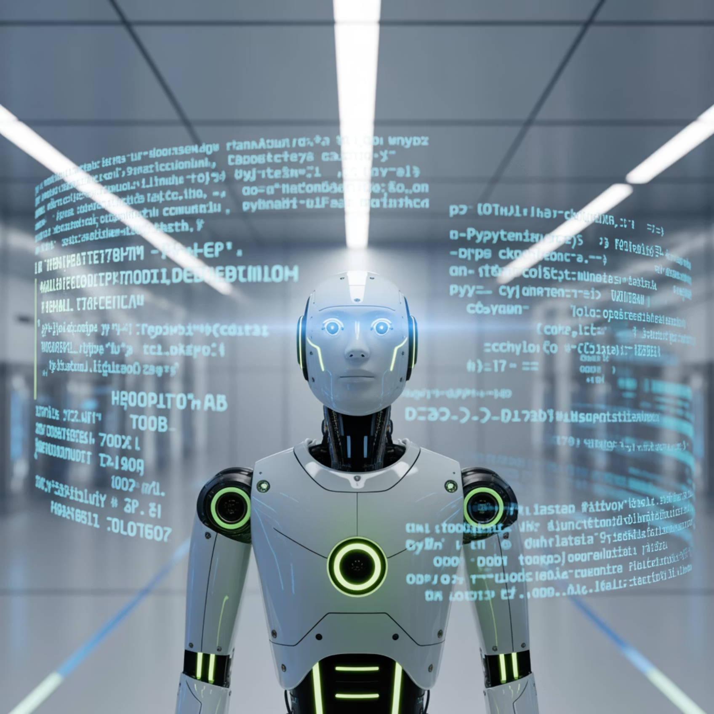
The Problem: Copilot is Only as Smart as the Context We Give It
AI in our IDEs has tremendous potential, but without proper standards and context, it produces generic code that doesn't align with our practices.
Each project in our organization uses different tech stacks:
Spring Boot microservices
React frontend applications
Python data processing pipelines
Full-stack applications with mixed patterns

Slide 3
The Consequences of Unguided AI
Inconsistent Code Patterns
Longer Code Reviews
Knowledge Silos
Developers using Copilot get different suggestions based on random samples rather than our established patterns
Reviewers spend extra time correcting style and architecture issues that could have been avoided
Senior developers must constantly enforce "tribal rules" that aren't documented or accessible to new team members
Without standardized guidance, we're not realizing the full potential of AI pair programming.

Slide 4
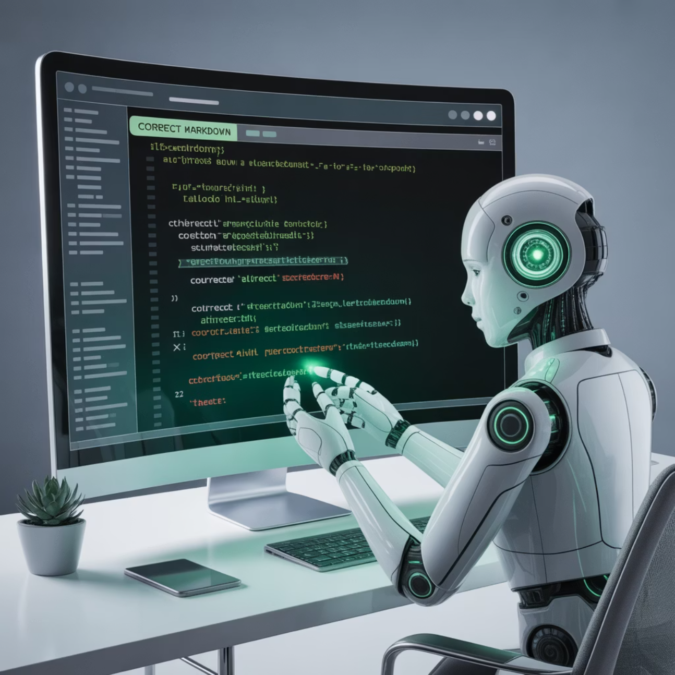
The Solution: Copilot Instructions
AI Standards File in .github/copilot-instructions.md
This special file lives alongside our workflows and provides Copilot with project-specific context and rules.
Think of it as "onboarding in a file" — it teaches Copilot how to write code the way we write code.

Slide 5

What Goes Into Copilot Instructions?
Coding Style & Naming Conventions
Architecture Patterns
Camel case vs. snake case, file organization, comment standards
Repository structure, dependency injection approaches, state management
Security Rules
Testing Conventions
No hard-coded secrets, proper authentication patterns, avoiding blocking calls
Test naming, mocking strategies, coverage expectations
The instructions file can be as detailed or minimal as needed, and can evolve over time as your standards change.

Slide 6

Business Benefits & ROI
70%
50%
35%
Less Time Reformatting
Faster Onboarding
Cleaner PRs
New team members can immediately generate code that follows team conventions
Reviews focus on logic and functionality rather than style corrections
Developers spend less time adjusting AI-generated code to match team standards
40%
Knowledge Democratization
All team members have equal access to best practices via their AI assistant

Slide 7
The AI Rules Landscape
Different AI coding assistants have their own implementation of rules files:
GitHub Copilot
Claude Code
.github/copilot-instructions.md
claude.md
Windsurf
Cursor
.windsurf.rules directory with .md rules files
.cursor rules directory with .mdc rules files
"Rules files are the new README. They are the AI pipeline for coding standards."

Slide 8

Demo: Seeing It In Action
Let's look at our automation framework repository:
Open .github/copilot-instructions.md
Examine our defined conventions
Watch Copilot generate code with our naming patterns
See how DTOs match our structure
Verify async calls follow our standards
This isn't theoretical—it's already working in our projects.

Slide 9




Implementation Roadmap
Create Template
Pilot in Key Repos
Develop a base instructions template that captures our core standards
Implement in 2-3 critical repositories and gather developer feedback
Team Customization
Organization-wide Rollout
Each team adapts the template for their specific tech stack needs
Standardize across all repositories with CI verification
We'll measure success through developer satisfaction surveys and PR metrics (comments, revision cycles, time to merge).

Slide 10

The Future of AI-Guided Development
"Copilot without instructions is like GPS without a destination. With instructions, it's turn-by-turn navigation for our coding standards."
Next Steps:
Standardize .github/copilot-instructions.md across all repositories
Create team-specific templates for different tech stacks
Develop a process for evolving instructions as our standards change
Our vision: AI that enforces conventions in real-time, not just suggests them—making quality part of the development process, not an afterthought.

